Slide 1
Pricing and Valuing Interest Rate Swaps on Bloomberg
NFEA
5th International Conference
Moscow
Timothy Murphy
Bond and Derivatives Specialist
Bloomberg Applications,
Bloomberg London

Slide 2
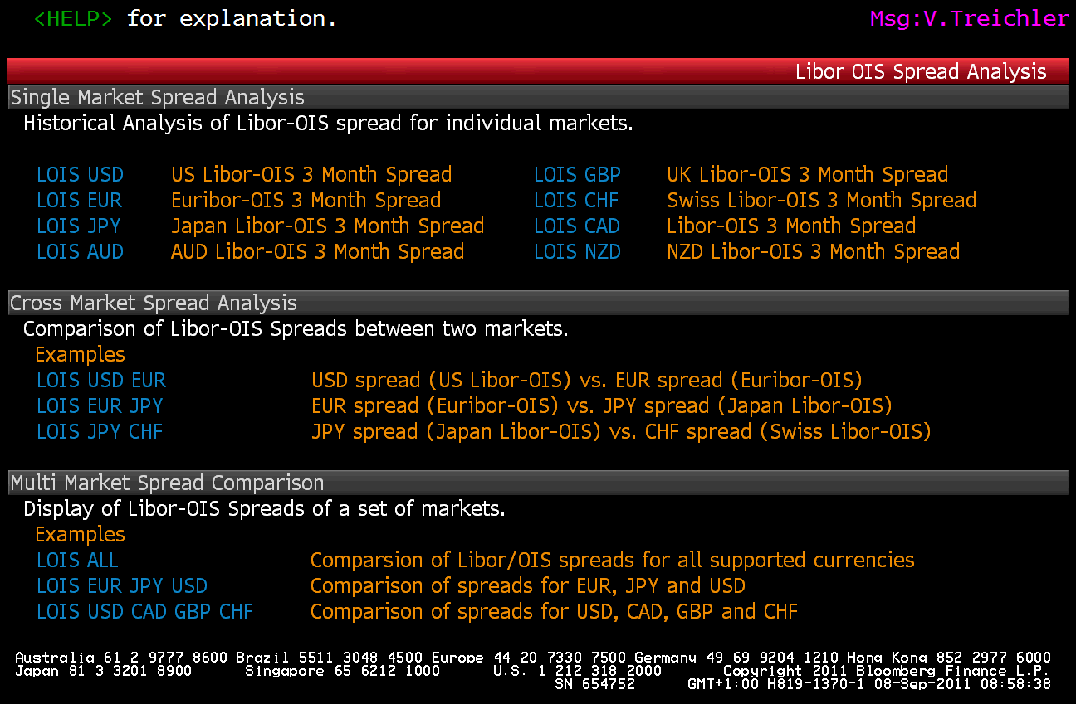
Viewing Libor OIS Spreads

Slide 3
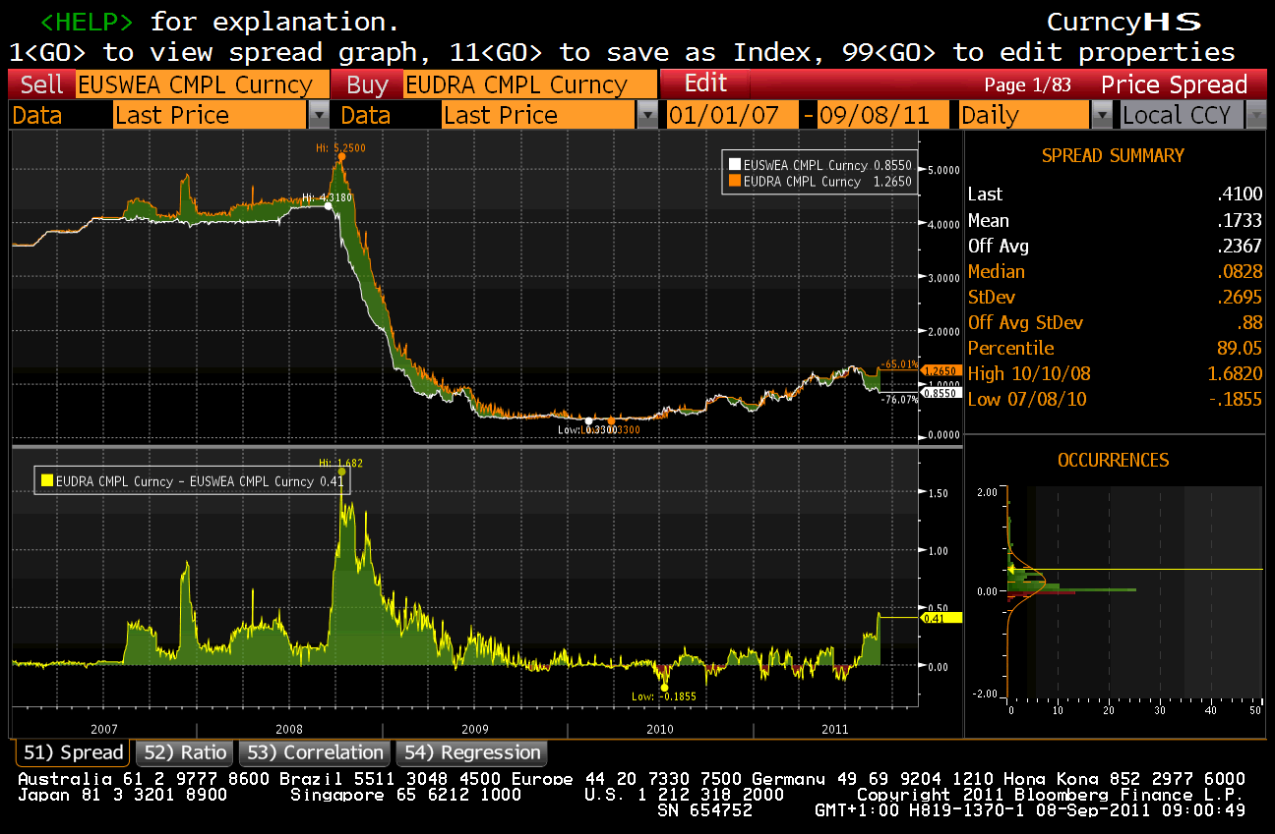
Viewing Libor OIS Spreads

Slide 4
Overview Bloomberg IRS Swap Functions
ILBM
ASW
CVA
OVME
OVML
SWPM
Structuring and Pricing
Derivatives Menu
<IRDV>
Swap Library: IRDL
Trade Execution and Monitor
Curve and Rate Analysis
SWDF: Swap Defaults
Portf. View: MARS
ICVS : Curve Construction
Rate quotes: BBTI
Volatility Analysis
VCUB
NSV
WIRP

Slide 5
BUILDING CURVES
SWDF
ICVS

Slide 6
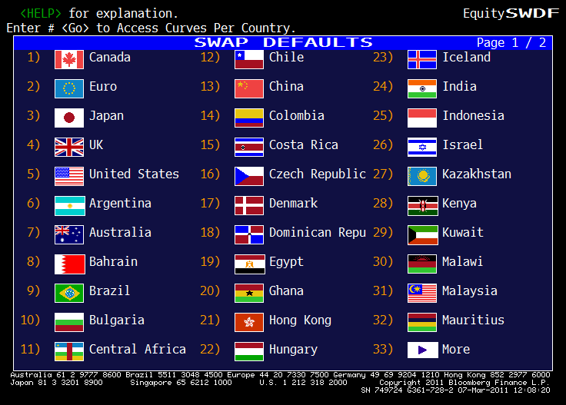
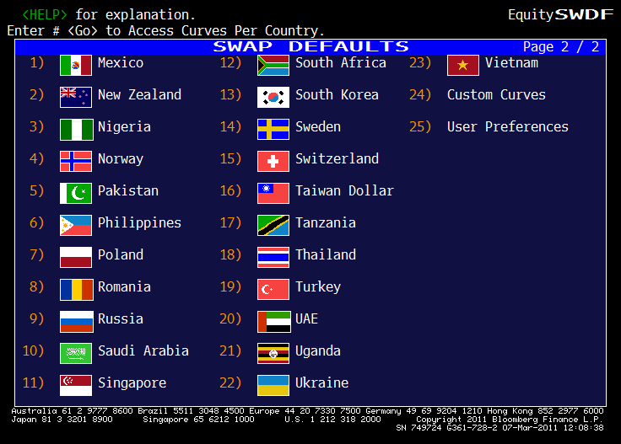
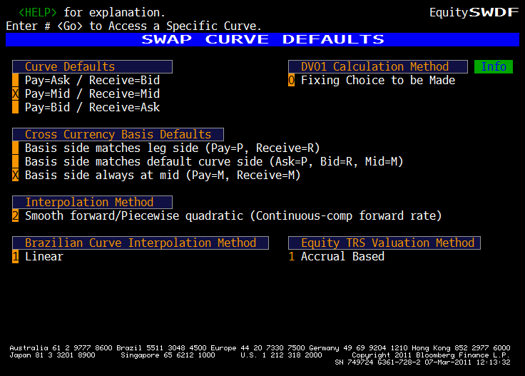
Setting Curve Defaults ->SWDF
It is important to verify the curve default settings as these feed into the valuation modules and can give rise to valuation differences between two users

Slide 7
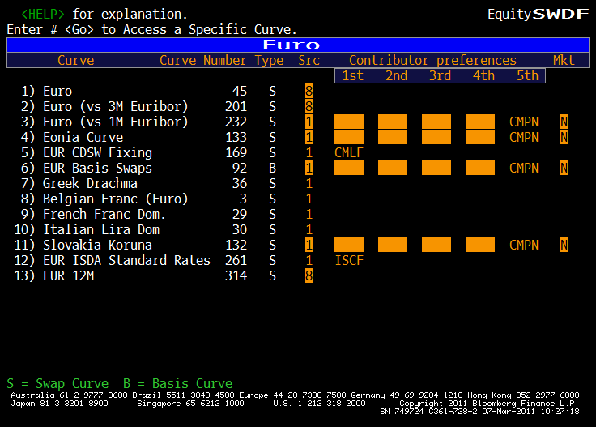
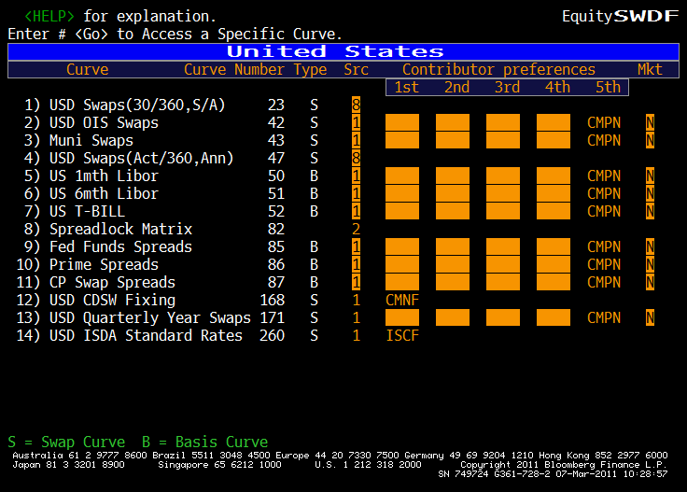
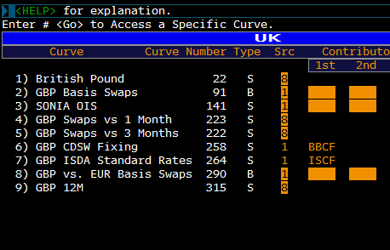
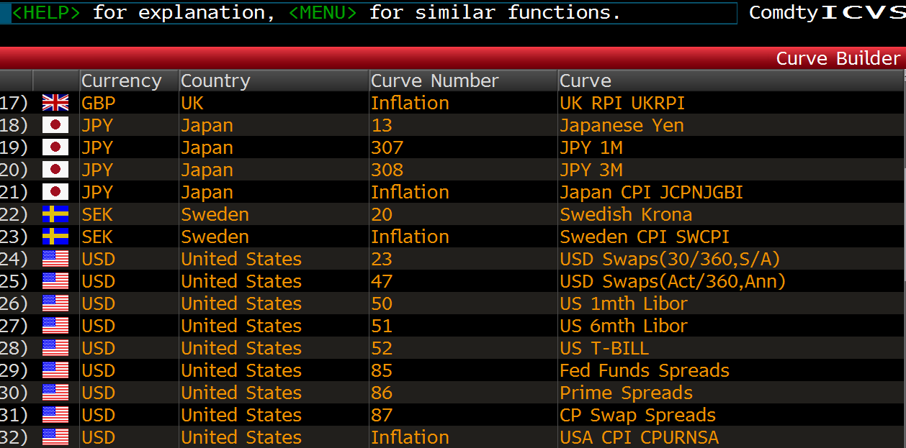
SWDF: IRS Curve IDs, Curve Sources and Pricing Settings
Curve Number is unique to each curve
Curve Source describes its creation method
However, note that SWDF does not list Inflation Swap Curves.
These can be found in ICVS

Slide 8
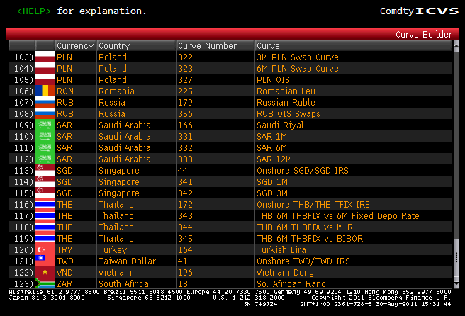
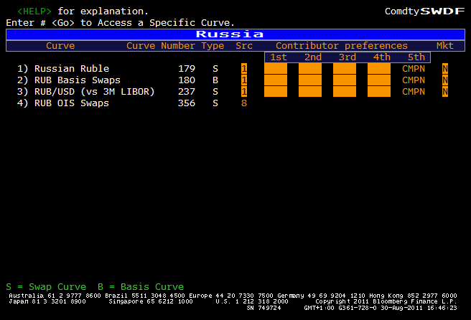
Russia Swap Curves on Bloomberg

Slide 9
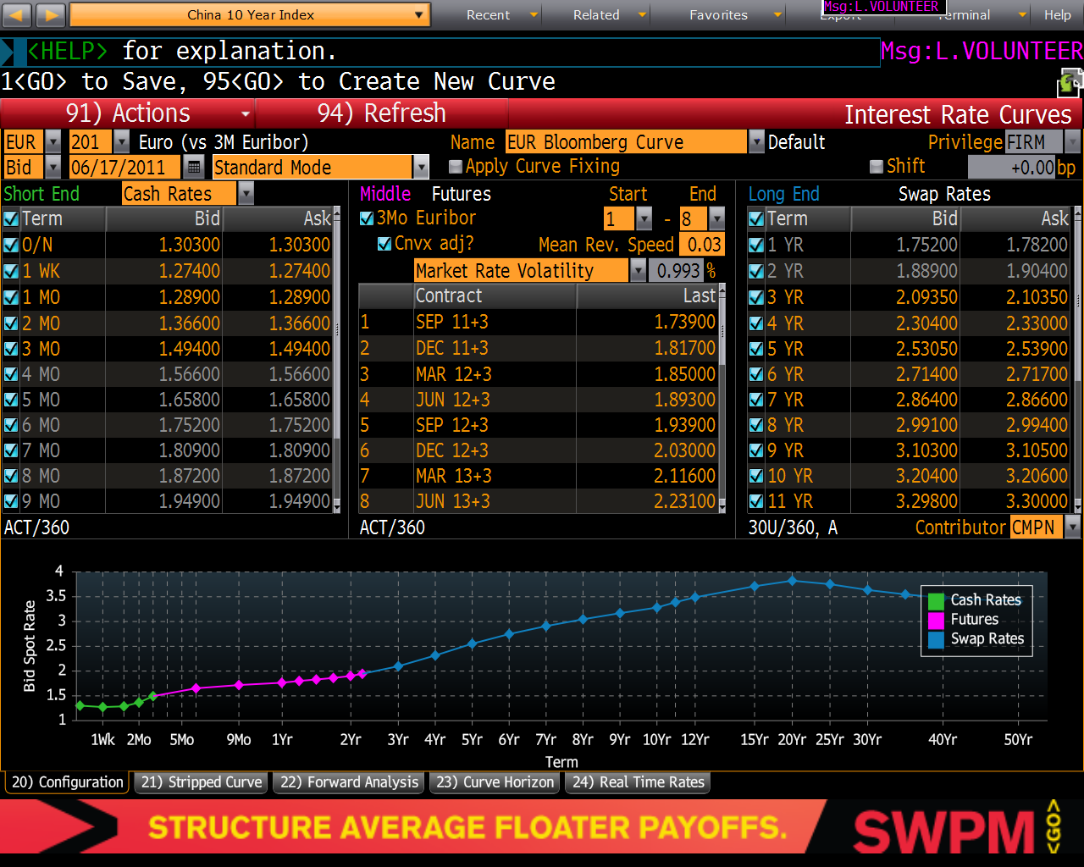
ICVS – Int. Curve Builder
“Source 8” Curve Constructions using 3 month reset Index
ICVS
3 month Futures used to bootstrap the zero coupon curve when quoting Swap vs. 3 months

Slide 10
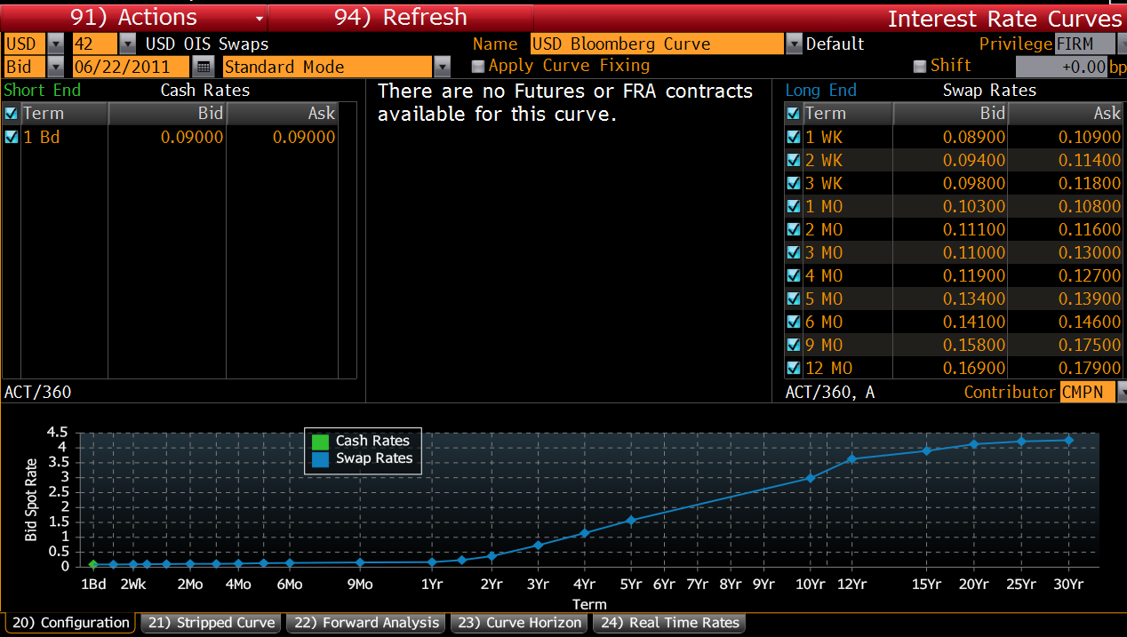
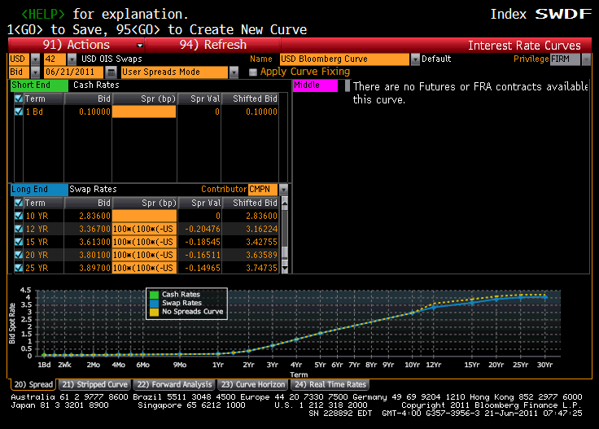
ICVS – Int. Curve Builder
“Source 8” Curve Constructions using OIS Rates
ICVS
As of 21 June, OIS source 8 curves are available in USD and CAD
Ensure settings in SWDF are set to select Source 8 curves.
For USD
Market quotes had been only out to 10 years.
Using SRC8, we EXTENDED to 30 years by calibration to US 3mo Libor vs Fed Fund Basis Swaps
Basis swap quotes → PREB item 8.
ICVS 42, in spreads mode
Shows our algebraic approximation for this
Calibration
refer to {NXTW IDOC #2063471 <GO>} explaining this method by
Zhenyu Wu (in Marcelo Piza's quant team).

Slide 11
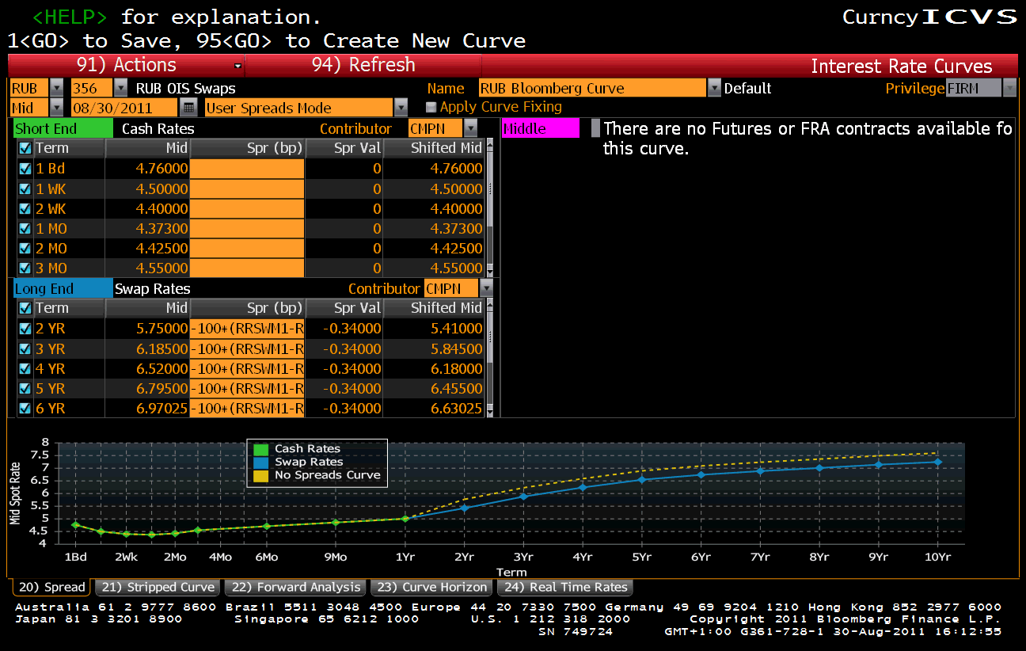
-100*(RRSWM1-RRSO1)
Where RRSWM1 = 1yr Rub Swap vs Mosprime 1 YR
And RRSO1 = 1yr Rub OIS Swap
-100*(RRSWM1-RRSO1)

Slide 12
1. Valuing a Vanilla Rouble Interest Rate Swap on Bloomberg
2. Valuing a Vanilla Euro Interest Rate Swap on Bloomberg using the EONIA Curve
3. Valuing a 5yr EONIA Interest Rate Swap on Bloomberg using the EONIA Curve

Slide 13
ENTERING INTEREST RATE SWAP TRANSACTIONS ON SWPM
Typing SWPM RUB <Go> opens up a plain vanilla Rub Fixed-Float Swap for 5 years
A more precise way would be
SWPM RUB –FXFL 2Y 100m <Go>

Slide 14
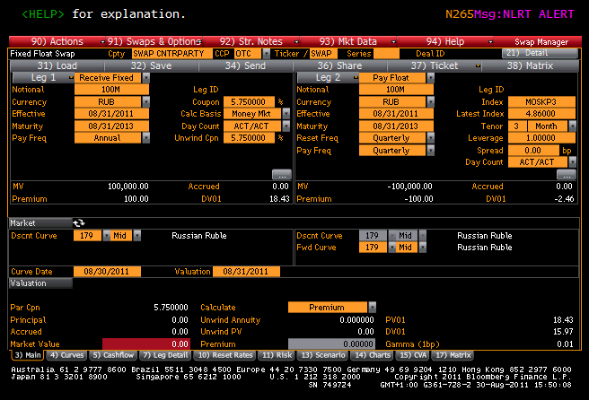
Standard 2y Swap SWPM –FXFL RUB 100m 2Y <Go>

Slide 15
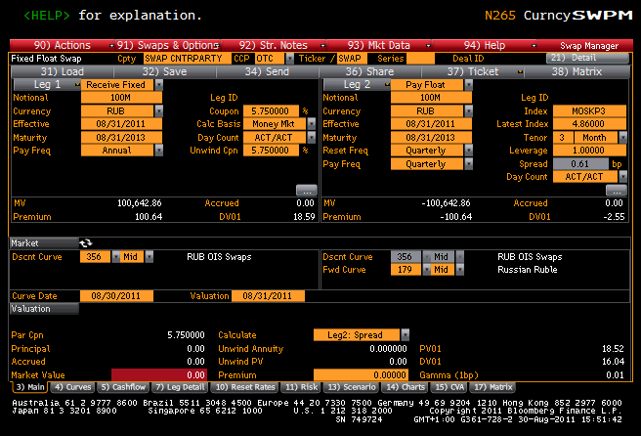
Changing the Discount Curve to OIS

Slide 16
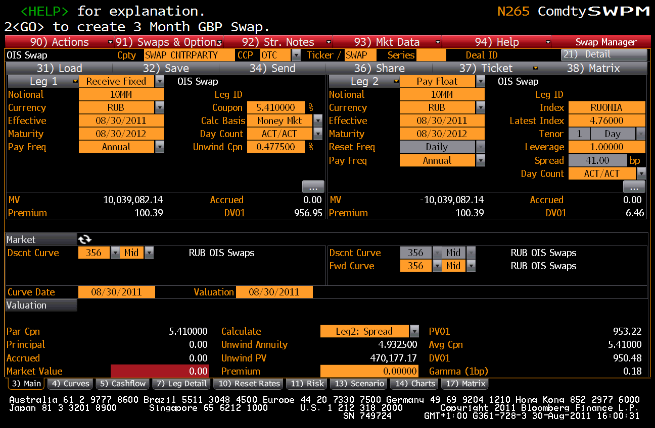
This is Different to Creating an OIS Swap

Slide 17
Questions?
Timothy Murphy
020 7392 0371
07939 257 308
tmurphy62@bloomberg.net
timothymurphy@mac.com

